Slide 1

Meet Manager 101
Presented by: Rich Lawlor - NCST

Slide 2
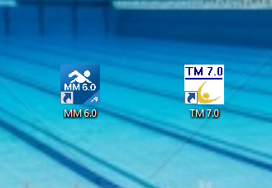
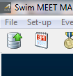

Meet Manager 101
Select the Meet Manager x.x Icon on your Desktop
Navigate to the ‘File’ selection on the MM toolbar
Double-click it!
Top Left-hand Corner!

Slide 3
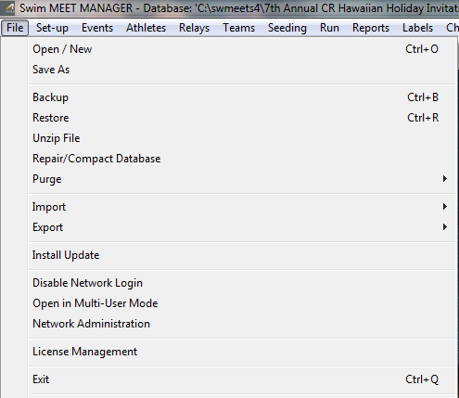

Meet Manager 101
After selecting ‘File’ select ‘Open/New’ from the drop-down menu

Slide 4
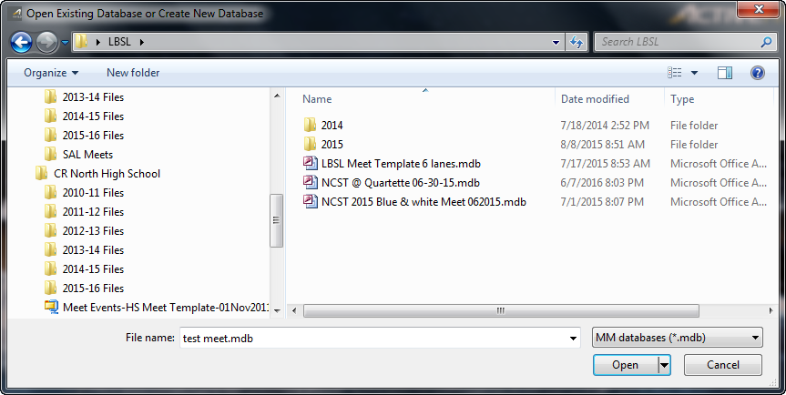
Meet Manager 101
Select an old meet database or the meet database provided
Double-click the database!

Slide 5

Meet Manager 101
Once you have selected the old meet database, you will see the database name at the top of the MM screen
You will need to be aware of the database title at all times
Check it often!!

Slide 6
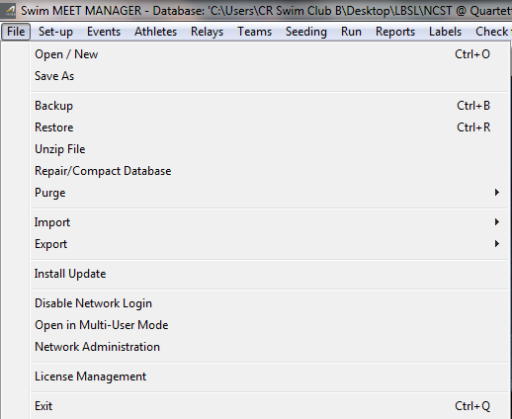

Meet Manager 101
Navigate to the ‘File’ selection on the MM toolbar, and select ‘Save As’

Slide 7
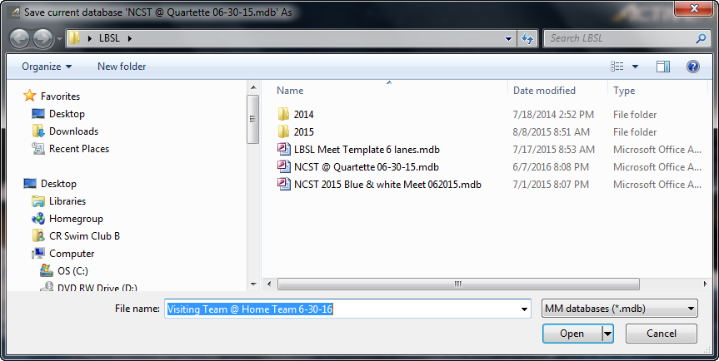
Meet Manager 101
Once you have selected ‘Save As’, you can rename the old meet to the new meet in this window

Slide 8
Meet Manager 101
After entering your new meet name in the ‘File Name’ field, simply click ‘Open’!

Slide 9

Meet Manager 101
Notice MM has changed the name of the current database to the name you entered on the ‘Save As’ screen
You will need to be aware of the database title at all times
Check it often!!

Slide 10
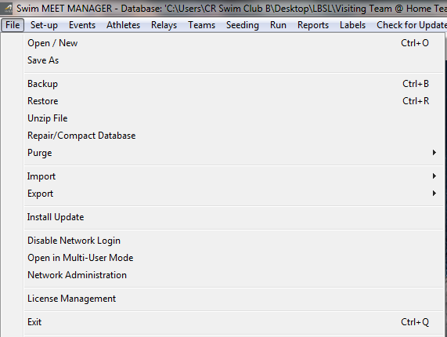

Meet Manager 101
Now the FUN begins!!
~~~~~
In the new database, navigate to the ‘File’ selection of the MM toolbar and select ‘Purge’
~~~~~
Be sure you are in the new database
Check the title!!

Slide 11
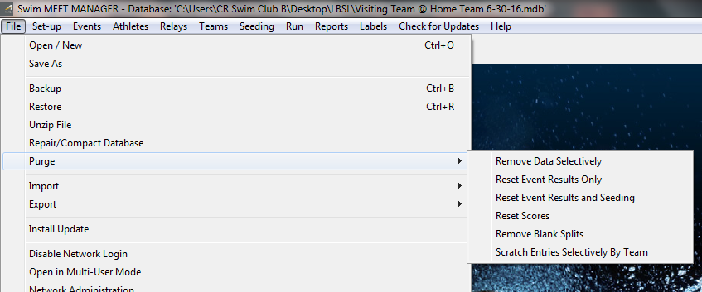
Meet Manager 101
Once you have selected ‘Purge’, a new drop-down menu will appear – Choose ‘Remove Data Selectively’
Once again be sure you are in the new database
Check it often!!

Slide 12
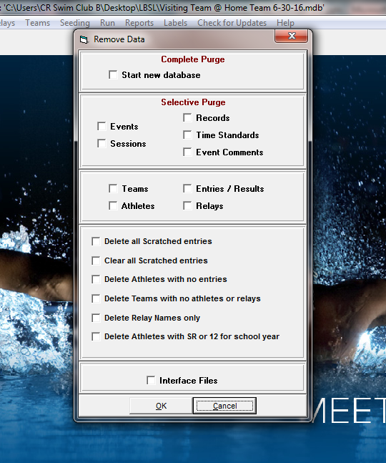

Meet Manager 101
After choosing ‘Remove Data Selectively’, a new pop-up window appears
~~~~~
In the ‘Remove Data’ window, you will select the ‘Teams’ box only!

Slide 13
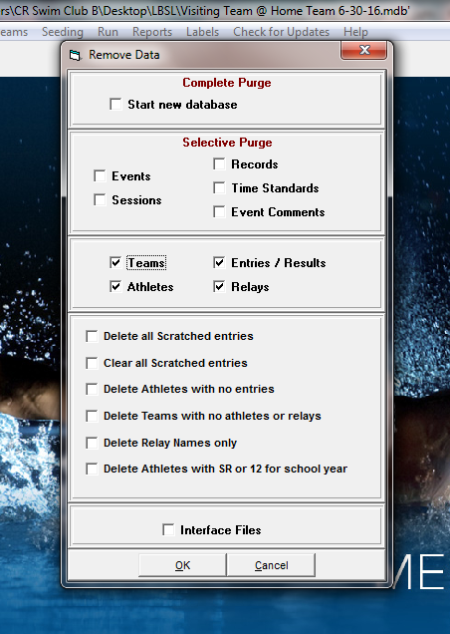

Meet Manager 101
Selecting only the ‘Teams’ box will auto-select these other necessary boxes:
‘Teams’
‘Athletes’
‘Entries/Results’
‘Relays’
~~~~~
Do not Freak out!
~~~~~
We want to clear the old data from our new database

Slide 14


Meet Manager 101
With these boxes selected, click the ‘OK’ button at the bottom of the ‘Remove Data’ window
~~~~~
Check your database title!!

Slide 15
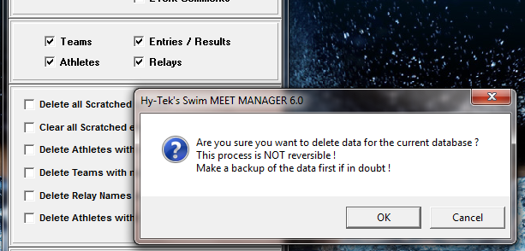

Meet Manager 101
A validation window will pop-up after you select ‘OK’
Simply click ‘OK’ again
~~~~~
Be sure to check your database name!

Slide 16
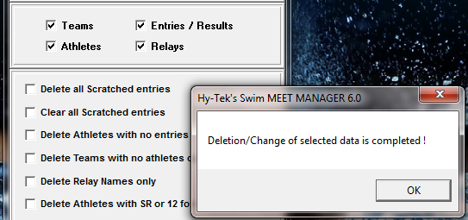

Meet Manager 101
A second validation window will pop-up
Simply click ‘OK’ once again
~~~~~
MM is asking you to ensure you have checked that database name!

Slide 17

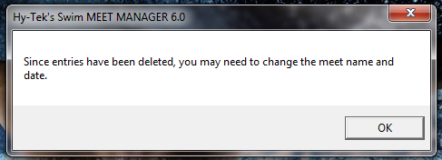


Meet Manager 101
One final pop-up window will appear letting you know you will need to update the database since you just ‘purged’ most of the data.
~~~~~
The best part is you have NOT purged any of the Meet settings:
# of lanes
scoring
Etc.
Simply click ‘OK’!

Slide 18
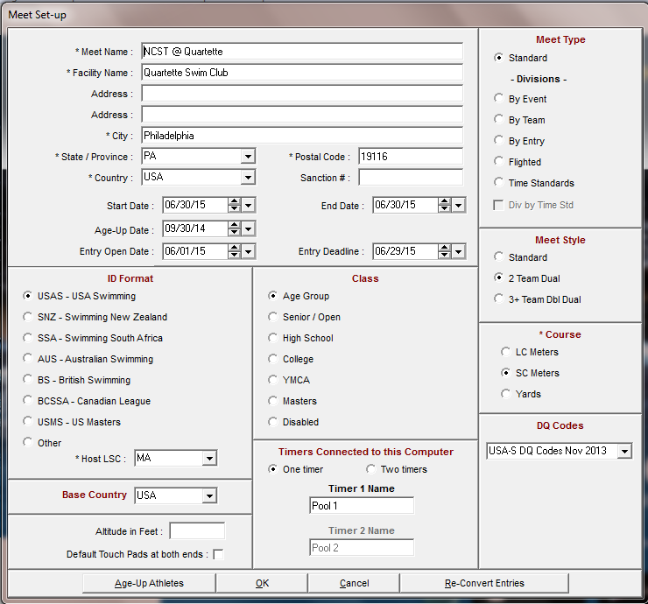
Meet Manager 101
The ‘Meet Set-up’ window will appear and you must update the fields with asterisks *:
‘Meet Name’
‘Facility Name’
Etc.
~~~~~
Also, revise the date fields to the current Meet date
~~~~~
*Note* - the ‘Age-up Date’ will always be 6/15/XX of the current year

Slide 19

Meet Manager 101
Many of the settings will already be set from the copied database:
‘Meet Type’
‘Class’
Meet Style’
‘ID Format’
Etc.

Slide 20
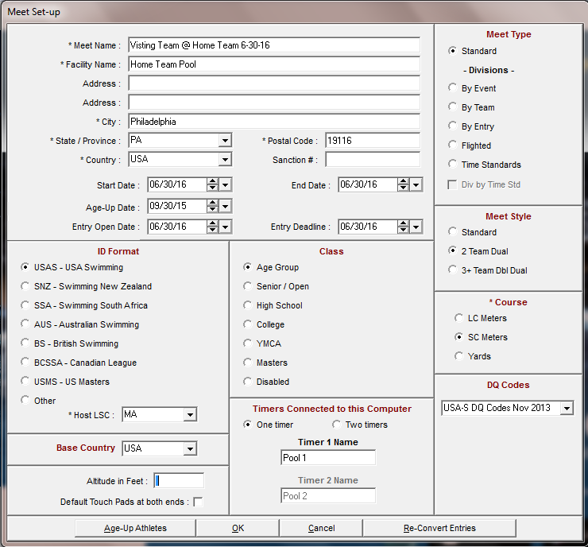
Meet Manager 101
*Note*
Use the same wording in the ‘Meet Name’ field as you used for the database name
~~~~~
This keeps everything consistent!

Slide 21

Meet Manager 101
Once you have updated all the necessary information, simply click ‘OK’ at the bottom of the ‘Meet Set-up’ window

Slide 22

Meet Manager 101
After updating the ‘Meet Set-up’ screen, and clicking ‘OK’, MM will return to the main screen.
*Note* If you were to select ‘Run’ at this time, you will see all the events are still there! However, there are no athletes or results. A ‘Clean Slate’!
This is a good time to check your database name to ensure you are in the correct Meet!!

Slide 23
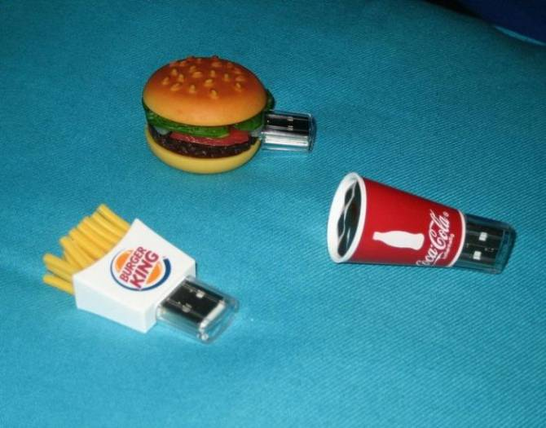
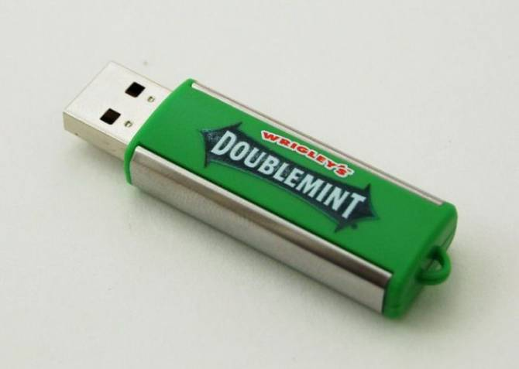
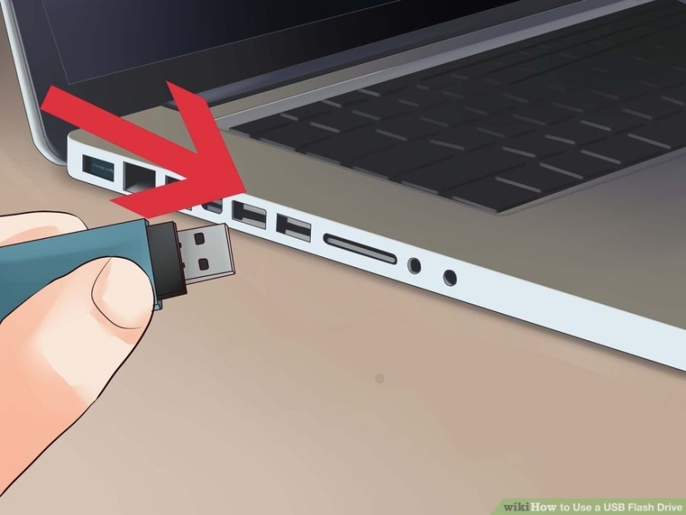
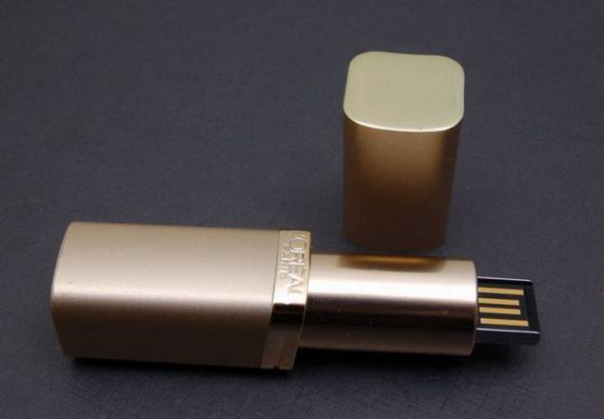
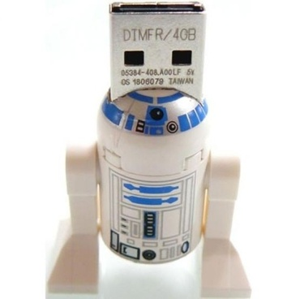
Meet Manager 101
Now you will need to insert the coaches’ flash drive(s) into a USB port on your computer or import the files from an email.

Slide 24
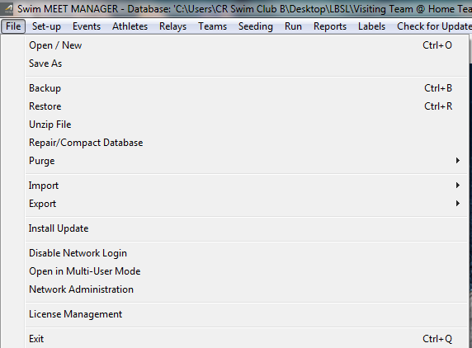

Meet Manager 101
With a ‘clean slate’ to build your new meet, navigate to the ‘File’ selection on the MM toolbar and select ‘Import’

Slide 25
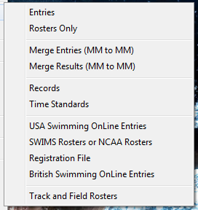
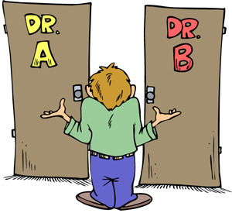
Meet Manager 101
Once you select ‘Import’, this pop-up appears.
~~~~~
You can select either ‘Entries’ or ‘Rosters Only’ in this window.
~~~~~
You must do both – if at all possible!!

Slide 26
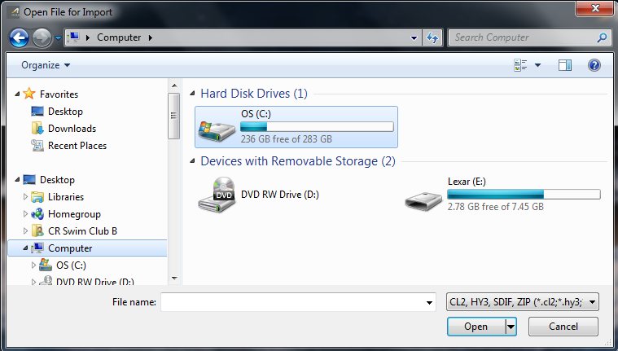
Meet Manager 101
Whichever file you choose, you must navigate to the USB flash drive or email file to import it into MM.
The drive letter may vary, i.e. ‘D’, ‘E’, ‘F’, etc.

Slide 27
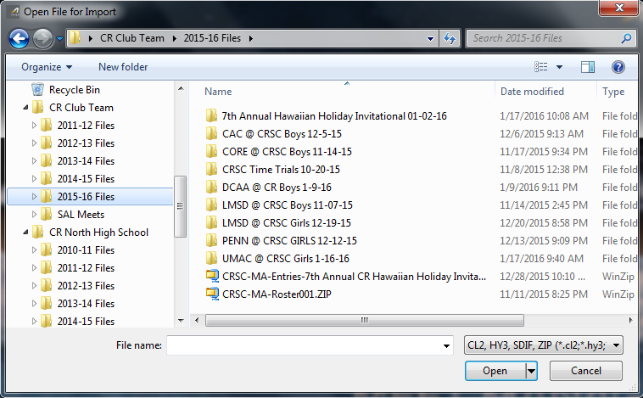
Meet Manager 101
Once you have located the correct file, double-click it!!

Slide 28
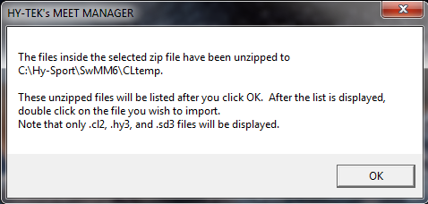
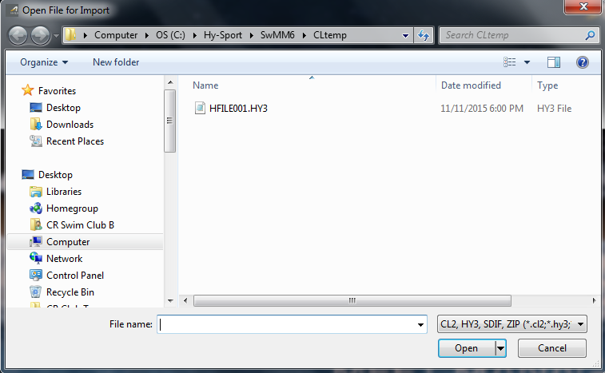
Meet Manager 101
After clicking the correct file, this pop-up will appear, simply click ‘OK’
A new window will open with the ‘unzipped’ file.
~~~~~
Double-click it!!

Slide 29
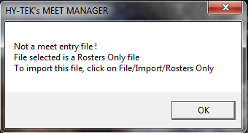

Meet Manager 101
If you mistakenly select the wrong file type, this pop-up will appear as a warning!
Simply click ‘OK’ on this window, and then the ‘Cancel’ button to start over.

Slide 30
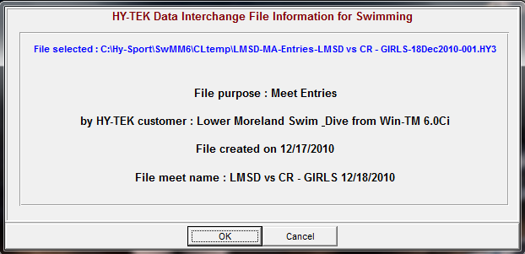
Meet Manager 101
After selecting the correct ‘Entries’ file, you will get this pop-up window. Select ‘OK’!

Slide 31
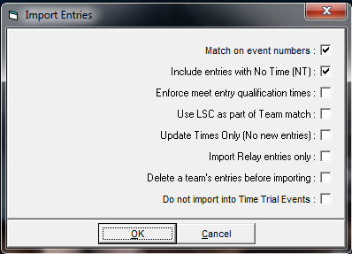
Meet Manager 101
Once you click ‘OK’, you will see this pop-up window. Again, select ‘OK’
*Note*
In this selection window, you should only have the top two boxes checked!!

Slide 32
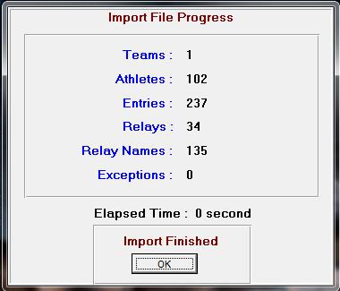

Meet Manager 101
Once you click ‘OK’, MM will import the entries and open this ‘Import File Progress’ window.
~~~~~
Click ‘OK’!
~~~~~
If no exceptions occur, MM will return to the main screen.

Slide 33
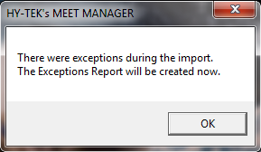
Meet Manager 101
If there are exceptions, MM will provide this pop-up warning
~~~~~
Click ‘OK’!

Slide 34
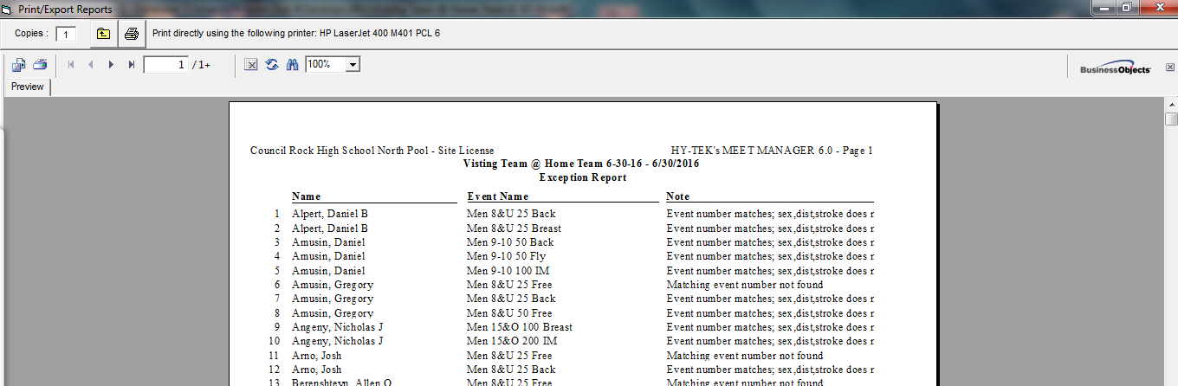
Meet Manager 101
Once you click ‘OK’, MM will create a report showing the exceptions. Exceptions can include double lane assignments, incorrect gender/event, etc. Print out the report by clicking the printer icon at the top of the screen. Once you print the report, simply close the ‘Print/Export Reports’ window.

Slide 35
Meet Manager 101
After printing out the exceptions report and closing the window, MM will return to the ‘Import File Progress window
~~~~~
Click ‘OK’

Slide 36
Meet Manager 101
With the exceptions report in hand, choose the ‘Run’ selection from the MM toolbar and access the event where the exceptions occur and update the necessary information, i.e. edit lane assignments, edit the swimmers, etc.
*Note* Suggest importing the roster files from both teams before editing the meet!

Slide 37
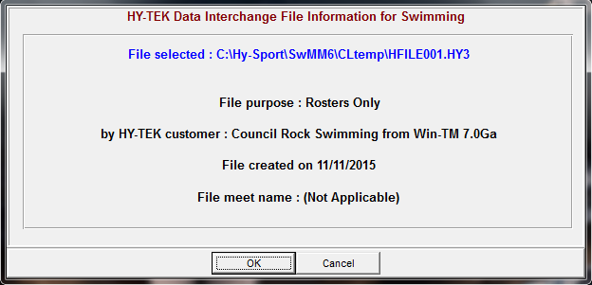

Meet Manager 101
Now that you have successfully imported the ‘Entries’ file, repeat the steps on slides 23 thru 27 to import the ‘Rosters Only’ file!

Slide 38
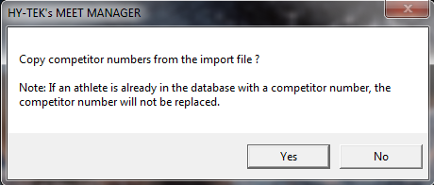
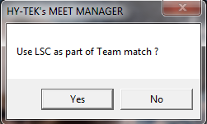

Meet Manager 101
When importing the ‘Rosters Only’ file, you will receive this pop-up window, simply select ‘No’!
You will then see this pop-up window, and again select ‘No’!

Slide 39
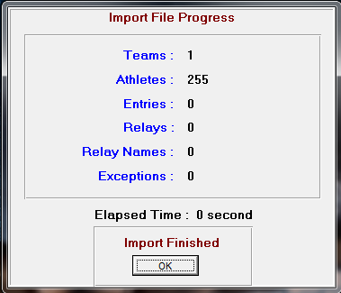

Meet Manager 101
Once you click ‘OK’, MM will import the selected roster file and open this ‘Import File Progress’ window.
~~~~~
Click ‘OK’!
~~~~~
If no exceptions occur, MM will return to the main screen.

Slide 40
Meet Manager 101
After you have successfully imported BOTH teams’ entries and roster files, navigate to the ‘Set-up’ selection on the MM toolbar.
This is a very important step, as you must tell MM how to score the meet!

Slide 41
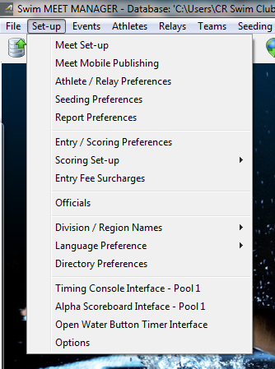
Meet Manager 101
After choosing ‘Set-up’ you will see this drop-down window appear.
~~~~~
Click on the ‘Entry/Scoring Preferences’ selection

Slide 42
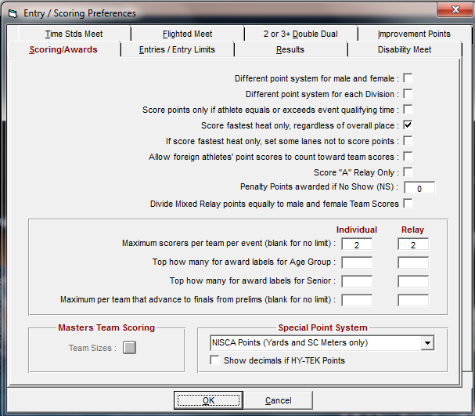
Meet Manager 101
When you select ‘Entry/Scoring Preferences’, you will see this pop-up window appear.
~~~~~
Select the ‘2 or 3+ Double Dual’ tab!

Slide 43
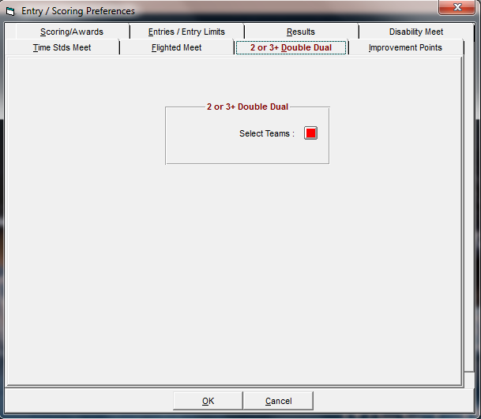
Meet Manager 101
The ‘2 or 3+ Double Dual’ tab will look like this.
~~~~~
Click on the red box next to ‘Select Teams’!

Slide 44
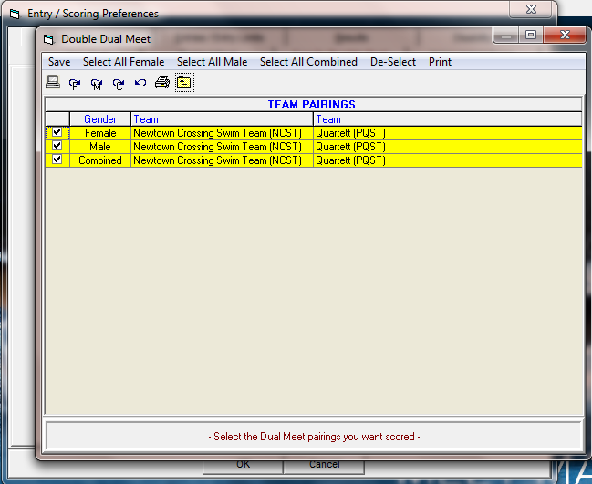
Meet Manager 101
After clicking on the ‘Red Box’, you will see this window appear.
~~~~~
You must check ALL of the boxes in the ‘Team Pairings’ section to ensure MM will score the meet correctly!
~~~~~
Then simply click ‘Save’!

Slide 45
Meet Manager 101
Once you have saved your ‘Team Pairings’, MM will return to the ‘Entry/Scoring Preferences’ window
~~~~~
Click ‘OK’!!

Slide 46


Meet Manager 101
After you have successfully imported BOTH teams’ entries and roster files, and correctly set up the ‘Team Pairings’, navigate to the ‘Run’ selection on the MM toolbar.
Selecting ‘Run’ will open up the ‘Run the Meet’ window, this is where you will make changes, enter results, etc.
~~~~~
Great Job!!

Slide 47


Meet Manager 101
Questions??
Now you can set up all of your meets for the entire season!!

Slide 48
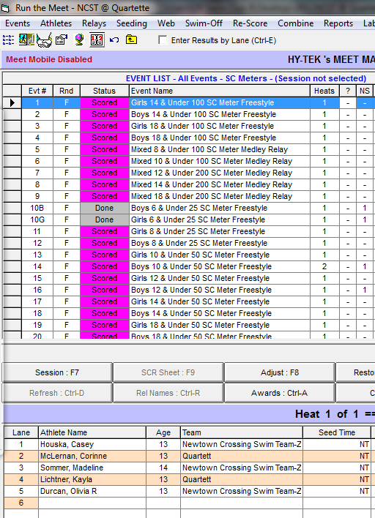
Meet Manager 101
Making Changes to the Meet!!
~~~~~
If you need to update an individual event, simply select the event and then click ‘Adjust’!

Slide 49
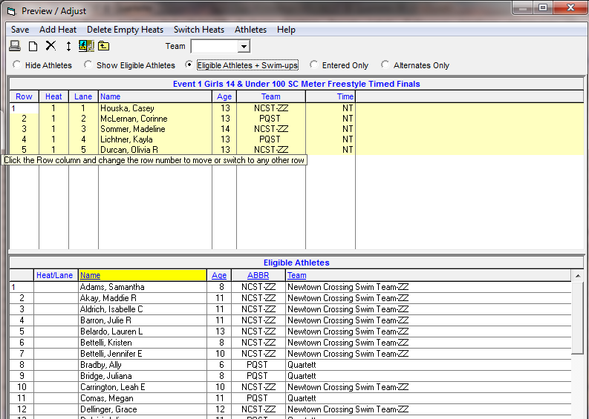
Meet Manager 101
After selecting ‘Adjust’, you will see this pop-up window appear.
~~~~~
Here you can move swimmers in and out of lanes, add swimmers into an event, add a heat, etc.
~~~~~
When you are finished making the updates, click ‘Save’!!

Slide 50
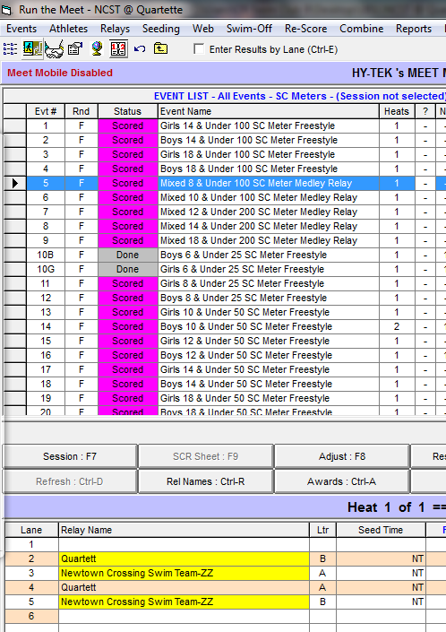
Meet Manager 101
If you need to adjust a relay event, select the correct event and then you can either select ‘Rel Names’ or ‘Adjust’

Slide 51
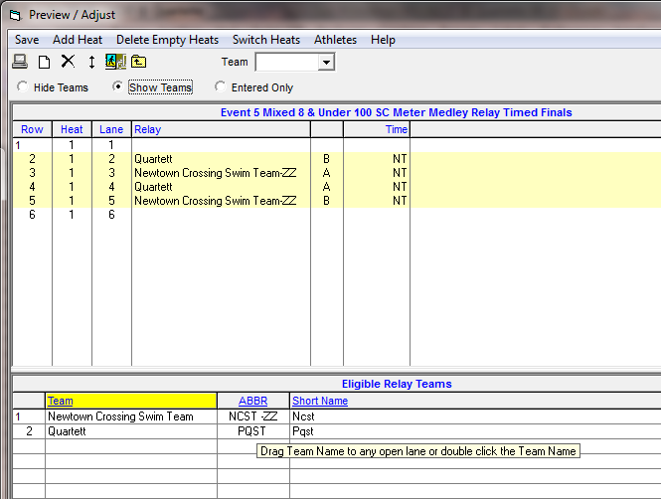
Meet Manager 101
If you select ‘Adjust’, you will see this pop-up window appear
~~~~~
Here you can add/move a Team’s relay into a lane
~~~~~
When finished, click ‘Save’!!

Slide 52
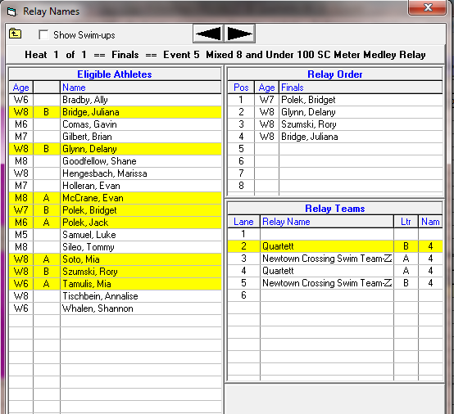
Meet Manager 101
If you select ‘Rel Names’, you will see this pop-up window appear
~~~~~
Here you can add/move a swimmer into a lane/relay
~~~~~
When finished, click the red ‘X’, MM will auto-save the changes!!

Slide 53
Meet Manager 101
Questions??

Slide 54
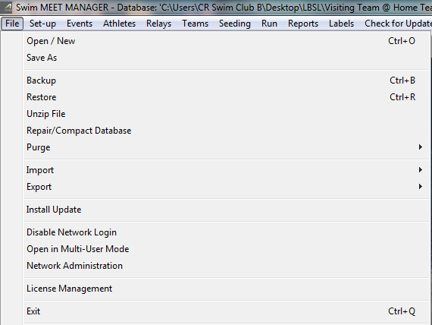

Meet Manager 101
After the meet has ended, you will need to ‘Export’ the results for the coaches.
~~~~~
Navigate to the ‘File’ selection on the MM toolbar and select ‘Export’

Slide 55
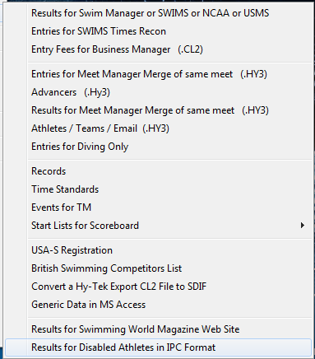
Meet Manager 101
When selecting ‘Export’, you will see this pop-up window. From here you will choose the first selection.
~~~~~
The actual wording may be different depending on your version of MM.
~~~~~
The selection will most likely refer to ‘Team Manger’ or ‘TM’, etc.

Slide 56
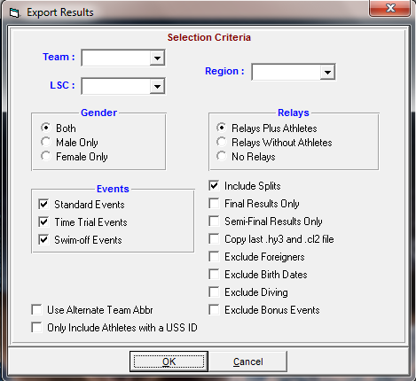

Meet Manager 101
After choosing the first selection, you will see a pop-up similar to this one.
~~~~~
Here you can select the Team’s file you will export, along with some other selections.
~~~~~
Then click ‘OK’!

Slide 57
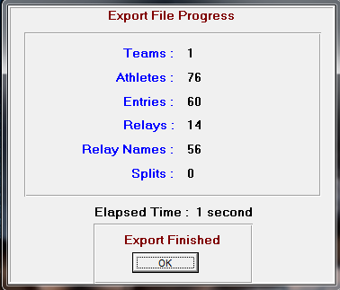
Meet Manager 101
After you have made the necessary selections, and click ‘OK’, MM will provide this ‘Export File Progress’ window
~~~~~
Click OK!!

Slide 58

Meet Manager 101
Then you will need to select the drive where you will save the exported file, and then click ‘OK’!

Slide 59



Meet Manager 101
If you have selected everything correctly, MM will provide this pop-up window. Simply select ‘OK’
~~~~~
Great Job!!

Slide 60
Meet Manager 101
Questions??
Any questions, email Rich --- rtlawlor1@gmail.com

